Slide 1

#ABrighterFuture
Our Draft School Vision

Slide 2

What is curriculum?
Currere – to run the course
Not a document that we
lift from the shelf but it is much broader than that and we need to think much broader when we design our curriculum.

Slide 3
What does curriculum mean to us?
Finding moment of magic and enabling our children to explore and learn what they want to as well as covering what we ‘have’ to teach.
Having a curriculum for purpose – what we went in to teaching for!
Why are we doing it? What do we want for our children?
We want a curriculum that the children care about and can be bothered about.

Slide 4
How have we put our vision together?
We spent time talking and thinking about curriculum and what our vision for our school curriculum would be.
The CFW gives us a framework to design our own curriculum, specific to our children and our community.
We needed to create our vision for what we want our ‘Pentrebane’ curriculum to look like.
It is up to us to make some really important and exciting decisions about how we want our children to learn.
MAKE IT PURPOSEFUL AND NOT CONTENT DRIVEN – WHAT DO OUR CHILDREN NEED?

Slide 5
Getting more out by putting less in!
The curriculum is the life blood of the school and it needs to have that weight out upon it. It isn’t just something that is typed up and put in a file or on the website!
It is an expression of our school community and what we believe, want, desire and think is important for our pupils.
We need to the learning to matter more to them – for it to be more engaging.
Curriculum should be a broad range of experiences , aptitudes, interactions and values for our children to practice before they have to go out into the real world and do it for real!

Slide 6
They need to see value in the now – the present time and not just be looking to the future.
We want to empower them to go out and change the world.
We need to give them real life experiences, within their community.
We need to prepare them for a world that some of us will never see!
We need to keep it real! Real life, genuine and authentic experiences that mean something to them.
Children move from engaged to invested! They are ‘bothered’.
Keep the children at the heart of everything we do.
Have some form of desirable difficulty – challenge – make things purposely difficult (mud pies) – Don’t take away the opportunities for failure.
Fluency of ideas. Our vision will continue to change and grow.
It needs to be a curriculum for our school with levels of progression where we know where we want our children to be going.

Slide 7
A vision for Pentrebane
Learner centred approach
Broad and balanced
Enriching experiences
Promotes active citizenship
Strong cross curricular links
Promotes and encourages challenge and aspiration
Develops a sense of Cynefin
Teaching through a blend of approaches

Slide 8
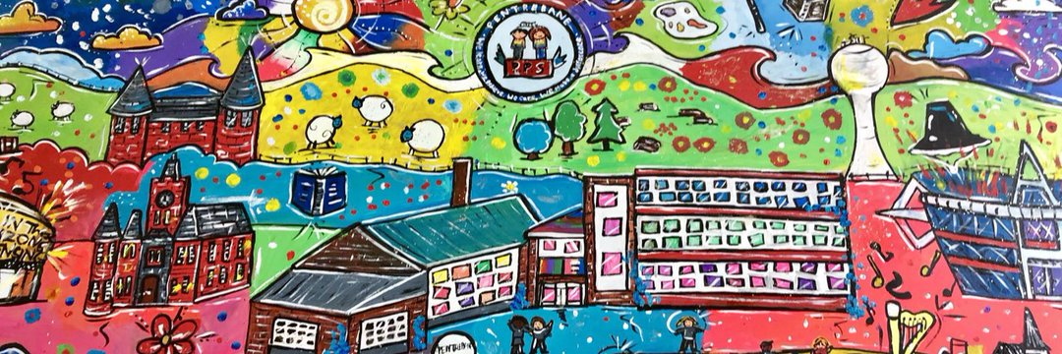
What do we want for our
Pentrebane Pupils? Our Vision

Slide 9
With the aim to move forward with CFW we now need to have feedback from you, as governors. Today I have a draft copy of the vision we have worked together on as a staff and myself as part of the Curriculum project.

Slide 10
"Since we cannot know what knowledge will be most needed in the future, it is senseless to try and teach it in advance. Instead we should try to turn out people who love learning so much, and learn so well, that they will be able to learn whatever needs to be learnt"
(John Holt)
At Pentrebane we aim to ignite in our pupils a love of learning which will serve them well throughout their lives.
“We learn, we achieve, we care, we make a difference”

Slide 11
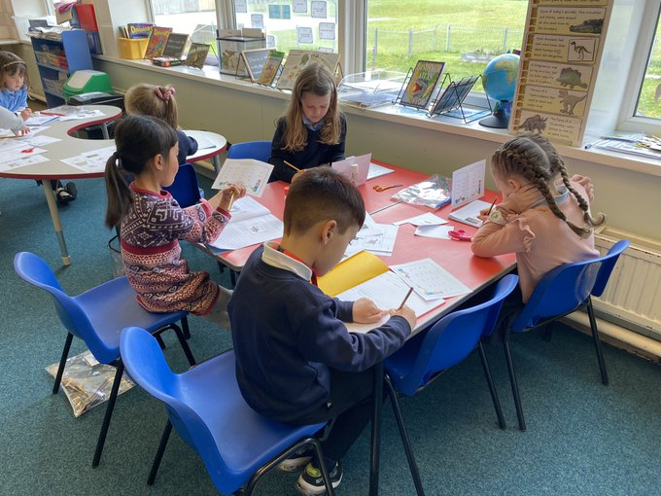
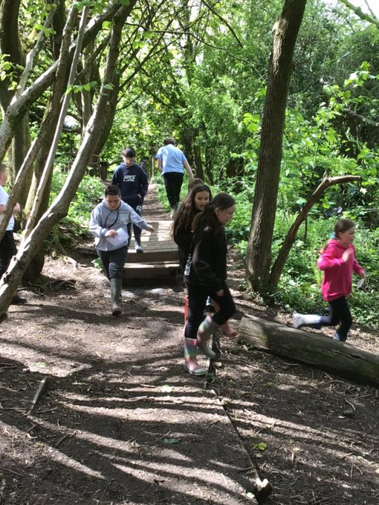
"A curriculum for Wales - A curriculum for Life"

Slide 12
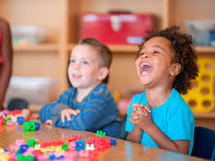

At Pentrebane we strive to find those ‘moments of magic’ that enable our children to explore and learn.

Slide 13
We want a curriculum that is all encompassing, a curriculum that the children care about and are invested in.
Our school curriculum is an expression of our school community and what we believe it is important and will enhance the life chances of
ALL our pupils.

Slide 14
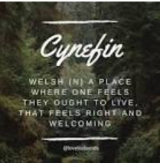
At Pentrebane we see everyone – pupils, parents, staff, governors and the wider community - as part of our Pentrebane family. We aim to develop a sense of Cynefin – to ensure that everyone feels a sense of belonging within our school, community and the wider world.

Slide 15

We want our children to know that they live and go to school in Wales. We want to give them opportunities to know their immediate area and how their locality and where they live affects their lives. We provide opportunities to celebrate living in Wales through culturally rich experience of the cultures, of Wales whilst also respecting the values of other cultures, communities, values and traditions.

Slide 16

The health and wellbeing of our staff and pupils is central to our school ethos. We see this as a vital ingredient in ensuring that our children feel loved, that everyone is respected and encouraged to develop to their fullest potential.

Slide 17
We understand the importance of promoting health and happiness, not just academic achievement.
We want to help them to build resilience and set the pattern for how they will manage their mental health and overcome obstacles throughout their lives. We also want to build a culture of trust where staff feel valued and supported, which is essential for cultivating a mentally healthy school.
We believe our pupils deserve an excellent education in order to prepare them academically and emotionally for the challenges they will face inside the classroom, and for the world they will enter when they finish school.

Slide 18
Good relationships are at the heart of everything we do. We understand the importance of positive relationships and secure attachments for our pupils. Not only with the staff, but with themselves, their peers, the school and their learning.
Within our school setting we nurture and support ALL relationships.
Our pupils should feel that their relationships with the adults in the school are positive, consistent, and based on trust and mutual respect.
We create clear, open communication with the parents of our pupils and involve them as much as possible in their children’s education. Building positive partnerships, understanding and trust help us to work together to support our pupils.

Slide 19
At Pentrebane our belief in “restorative approaches” ensures that every child is listened to.
We are a Restorative Approach school and understand that the relationships in a child’s life are essential to their wellbeing and development.
We believe that for a child to flourish and achieve in our school they need to know and understand their rights, to feel safe and to know that they belong and are a valued part of our school community. We teach, practice and promote children’s rights as an integral part of school life. We believe that a safe and happy child is a successful one.
The adults in our school are positive role models for our children influencing behaviour, relationships and decision making. We set high expectations that motivate our children to be the best version of themselves.

Slide 20
We want to create a positive school culture where our teachers are excited and to start each lesson with enthusiasm.
We want to hear laughter in the corridors when are pupils are coming into school.
We believe that creating a positive school culture has an impact, not just on the attitudes of students and teachers, but on the entire learning experience.
Our school ethos is to always provide the very best for our children
The BEST education
The BEST environment
The BEST platform for THEIR future

Slide 21
We aim to provide a consistent, protective and nurturing environment, within our indoor and outdoor learning spaces, that allows our pupils to thrive and provides them with time and space to develop emotionally and academically.
We want to develop a friendly, fun atmosphere where
wellbeing of ALL is paramount.

Slide 22
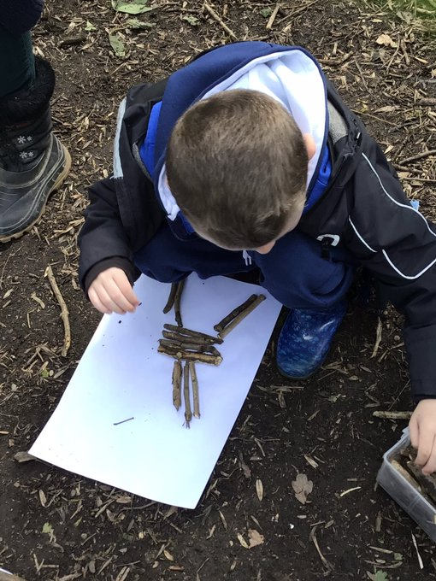
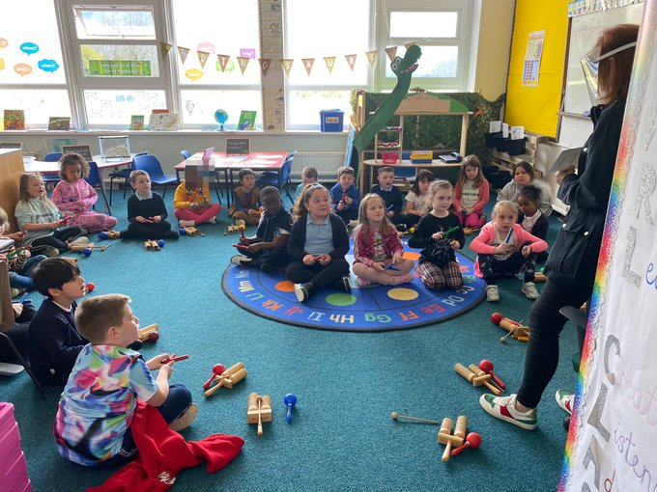
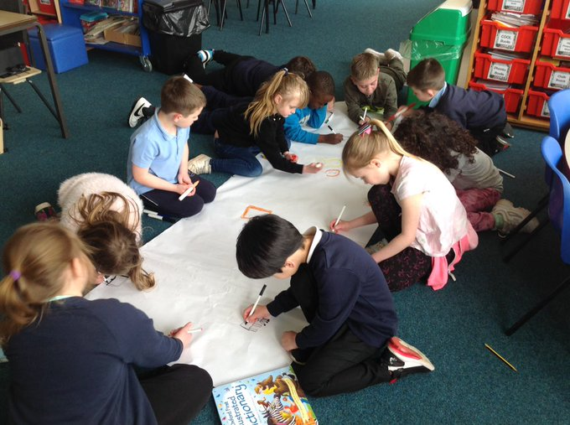
Our school is a place where children feel safe and secure. Where they are willing, and able, to take risks in their learning, in an environment that encourages risk, with resilient, creative and enterprising children.

Slide 23
Our classrooms are fully equipped with the necessary resources that allow our pupils and staff to thrive and have the confidence to develop their resilience and independence. We adopt a range of pedagogical teaching and learning approaches that are suitable to the varying needs of our pupils.
Our outdoor learning spaces provide an environment that not only develops their physical health and well-being but also supports their problem-solving skills, nurtures their creativity, as well as providing rich opportunities for developing their imagination, inventiveness, resourcefulness and the ability to take risks in their learning and play. They allow our children to participate in a curriculum that is rich in experience and allows them to develop an understanding of themselves and the world around them.

Slide 24
We believe that our children learn best through practical 'hands on' learning opportunities that enable them to experience real-life, authentic learning in a meaningful way and reflects their interests and needs.
Our curriculum is a purpose led curriculum. We want our pupils to be engaged and to see the purpose in their learning.
Working with a sense of purpose and meaning engages our pupils in learning new concepts and motivates them to persist through challenges.
We tailor our learning to provide children with opportunities to develop skills and explore concepts. These allow them to build on their knowledge and understanding through topics that capture their interest and stimulate their imagination; developing the ownership of what they are learning and, in their decision, making. We strive to develop their independence and self efficacy; to prepare them for change and the challenges they will face in a rapidly changing world.

Slide 25
We recognise our children's unique talents and encourage them to develop them further.
Success is achieved through lively, enquiring minds that recognise, and celebrate, their own and others’ achievements.
We develop their understanding of our core values of
KINDNESS, HONESTY and RESPECT
This is intrinsic to the language of our school and help us to develop their understanding of how to treat others and how they wish to be treated by celebrating diversity; supporting them in recognising that everybody is different and that everyone is equal.
We value all pupils' contributions to all aspects of school life and support them to become healthy, confident individuals.
We want to develop and nurture ethically informed individuals, enabling them to develop an empathy for their local community, Wales and the wider world.

Slide 26

We aim to develop an enthusiastic, innovative learning community where our pupils feel important and empowered, enabling them all to have self-belief, confidence and high aspirations. that in turn enables them all to achieve high standards in their learning.
We hold these aims as the key to success in securing literate and numerate children.
They will then be well equipped to meet the challenges in the next stage of their learning journey.

Slide 27
Learning Together:
We believe that every member of our school community is a learner - pupils, staff, parents and governors.
We invest in the most important and valuable resource in our school – our staff and promote their learning and development.
We work together to develop as a learning organisation to develop new skills, using information from research, other schools, businesses and the real world to build a culture for continuous improvement.
We encourage innovation in the classroom and use a range of pedagogical teaching and learning methods.
We share good practice and in collaboration with our cluster schools, our teachers are involved in trialling new methods of teaching based on research and look at how they can be implemented in our school.

Slide 28
Curriculum for Wales, Journey to 2022
What next?
Engagement
Designing, planning and trialing
Evaluating and preparing for first teaching
Vision
Understanding the model
Leading pedagogy
Time and space for PL
1) The curriculum for Wales model
2) Models of curriculum development
3) AoLE Design Considerations and Professional Learning
4) Progression and Assessment
Culture of research and enquiry
Effective Leadership of Change

